Slide 1
Несплошной текст – текст, который включает вербальные фрагменты (слова, предложения) и визуальные ряды (график, таблица, схема, диаграмма), необходимые для понимания текста
Диаграмма
A diagram
Таблица
A table
Схема
A chart
Виды несплошных текстов
Гистограмма
A histogram
Круговая диаграмма
A pie cart
График
A line graph
Столбчатая диаграмма
A bar chart

Slide 2
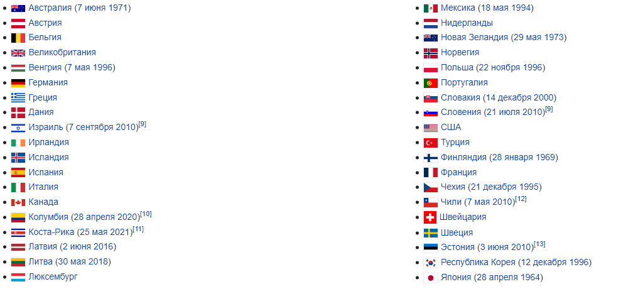
OECD (Organization for Economic Co-operation and Development)
38 Participating countries

Slide 3
Study the Following Words and Expressions
Expense(s) [ɪksˈpens] – расход(ы)
Account [əˈkaʊnt] – счет, расчетный счет
Bank account [bæŋk əˈkaʊnt] – банковский счет
Savings account [ˈseɪvɪŋz əˈkaʊnt] – сберегательный счет
Bank interest [bæŋk ˈɪntrest] – банковский процент
Savings [ˈseɪvɪŋz] – сбережения
Receipt [rɪˈsiːt] – квитанция
Bill – счет, выписка
Utilities [juːˈtɪlɪtɪz] коммунальные услуги
Budget [ˈbʌʤɪt] – бюджет, family (household) budget – семейный бюджет
Income [ˈɪnkʌm] – доход
Profit [ˈprɒfɪt] - прибыль
Earnings [ˈɜːnɪŋz] – заработок, выручка, прибыль
To earn [ˈɜːn] money – зарабатывать деньги
Own money – личные, собственные деньги
Pocket money [ˈpɒkɪt ˈmʌnɪ] – карманные деньги
Online banking [ˈɒnlaɪn ˈbæŋkɪŋ] – онлайн-банкинг
Coin [kɔɪn] – монета; banknote [ˈbæŋknəʊt] – банкнота
Currency [ˈkʌrənsɪ] – валюта, национальная валюта
OECD – Organization for Economic Co-operation and Development – Организация экономического сотрудничества и развития (38 стран-участниц)

Slide 4
Financial Activity of Russian Teenagers
Have a look at the diagram and say:
How often do Russian teenagers perform financial operations?
What kind of transactions are these operations?
Which of them are the most popular/least popular between teenagers?
How many teenagers do online shopping regularly? Do you like to shop online? Why/why not?
Do you take part in family budget calculation? What part of family budget do your parents spend on your expenses?
6. Have you ever paid bills for utilities (коммунальные услуги)?

Slide 5
Sources of Money for Teenagers

Slide 6
Составьте предложения с использованием числовых данных из диаграммы “Sources of Money for Teenagers”:
The difference between the number of the teenagers in Russia who do / are / have… and foreign teenagers who do / are /have … is only (…%).
There are nearly as many Russian teenagers who have … as foreign teenagers who have … .
Compared to only (…%) of the students who do / are /have… .
There are not many teenagers in Russia who do / are / have … compared to the number of teenagers abroad.
Russian teenagers, like foreign teenagers …. .
The number of the teens in Russia who … is almost the same in comparison to the number of the teens in OECD countries who … .
Составьте предложения с использованием числовых данных из диаграммы “Sources of Money for Teenagers”:

Slide 7
Making a purchase decision

Slide 8
Usage of bank cards and other bank products by Russian teenagers
How many Russian teenagers have a bank account? What kinds of bank accounts do you know?
Is the number of teenagers who have a bank card bigger than those who don`t have such a card?
How many teens in Russia have a bank mobile application? Do you have a bank mobile application? What purpose do you use it for?
How many Russian teens have never heard about a bank account?
What is more convenient for you, to pay by bank card or to pay in cash?

Slide 9
Sources of Financial Information

Slide 10
Imagine that you are doing a project on the sources of financial information for Russian teenagers. You have found some data on the subject:
Comment on the data in the diagram and give your opinion on the subject of the project:
Use the following plan:
make an opening statement on the subject of the project;
select and report 2-3 facts;
make 1-2 comparisons where relevant and give your comments;
conclude by giving your opinion on the importance of being well-educated in the field of finance.

