Slide 1
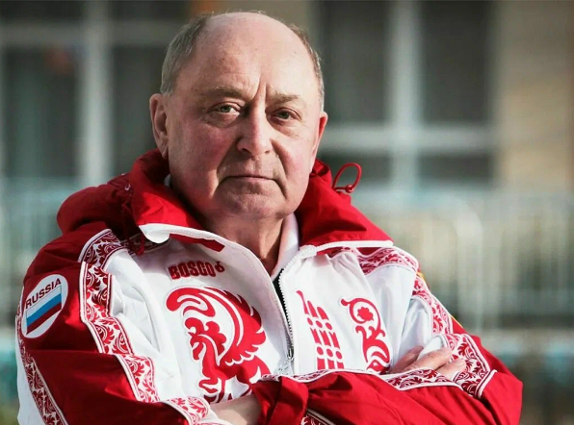
His name is the pride of Russia
(Его имя – гордость России)

Slide 2
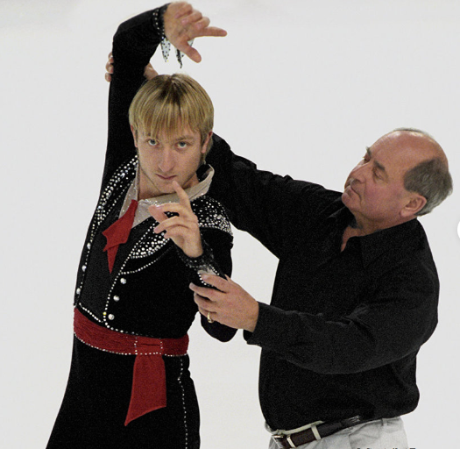
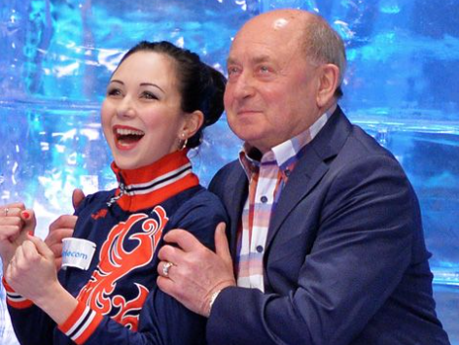

Slide 3
Task 2. Text “The Path to Success”
- was
- second
- became
- later
- his
- the most complex
- are used
- dedicated
- sportsmen
Answer the Questions to the text “The Path to Success”
Where and when was Alexei Mishin born?
How many children were there in his family?
Did he go in for sports late? At what age?
When did Alexei Mishin win the first gold medal?
Who were his teachers in figure skating?
Who are the most famous A.Mishin`s pupils?

Slide 4
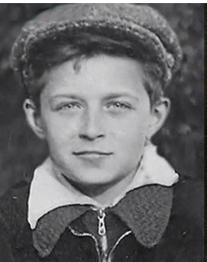
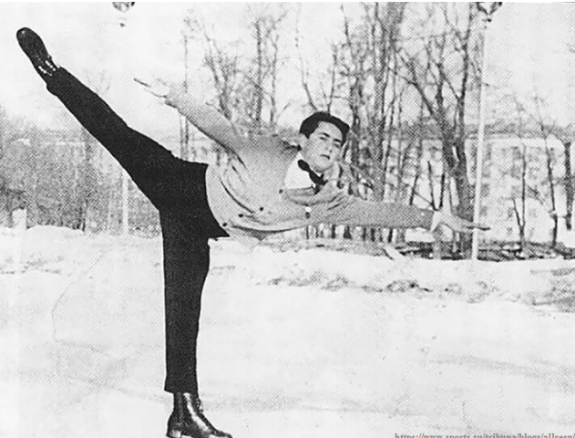
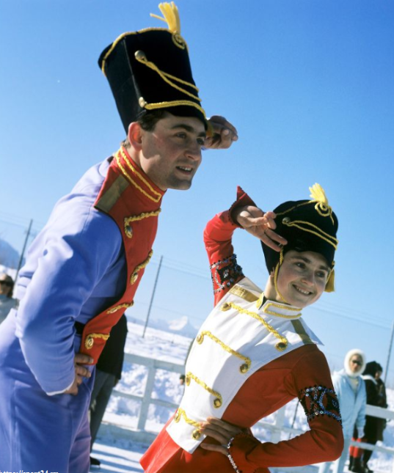
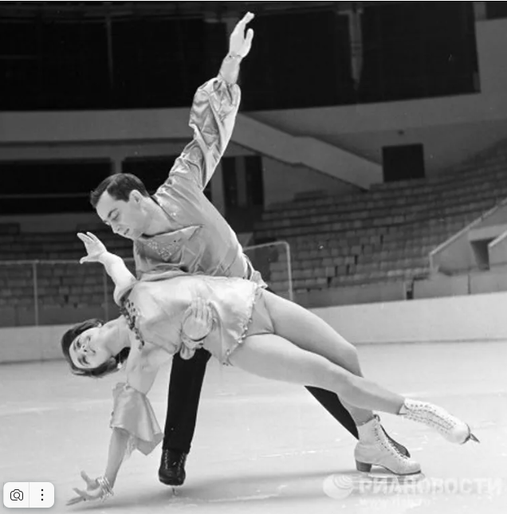

Slide 5
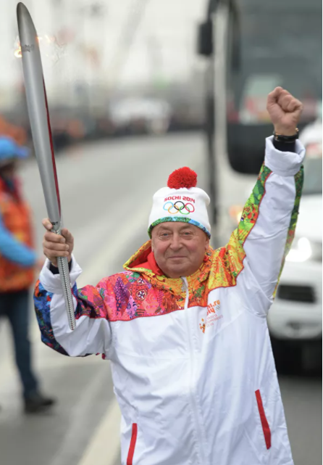
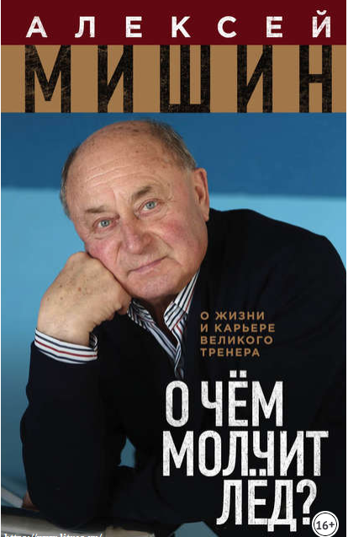

Slide 6
Task 3. Interesting Facts about A. Mishin`s life
a. Since 1967 Alexei Mishin took part in sport events as a pair skater with Tamara Moskvina, and in 1969 he became the USSR champion in pair skating. Among his sporting achievements are: 2nd place at the World Championships in 1969, 2nd place at the European Championships in 1968, and 3rd place at the European Championships in 1969.
b. In October 2013, Alexey Mishin took part in the Olympic torch relay (эстафета Олимпийского огня) in St. Petersburg. It was a great honor for him.
c. Alexey became a figure skater unexpectedly. His older sister Lyuda gave him skates as a present. Alexey was already 15 years old and the trainers didn’t want to take him to the section. But Alexey quickly became one of the strongest figure skaters.
d. Little Alexey was only 3 months old when the Great Patriotic War began. The hungry war time affected the boy's health. He fell ill with rickets (заболел рахитом) and did not speak until he was 3 years old.
e. At 76 years old Alexey Nikolaevich Mishin was inducted into the World Figure Skating Hall of Fame (был включен в Зал славы мирового фигурного катания). Mishin became the third Russian trainer to be inducted into the Hall of Fame after Tamara Moskvina and Tatyana Tarasova.
1 | 2 | 3 | 4 | 5
d | c | a | b | e

Slide 7
Task 4.
Work in groups of 4-5 people. Imagine, you are foreign journalists, who have an opportunity to take an interview with Alexei Mishin. In five minutes you are to ask 5 questions to find out the following information:
1) his childhood
2) his parents
3) his pupils
4) his hobby
5) his achievements as a figure skater

Slide 9
-Was the lesson interesting and useful for you?
- Do you know now who Alexei Mishin is?
- Can you tell about him and his achievements?
- Is he really a person Russia is proud of?
HOMEWORK: Подготовьте рассказ на английском языке об одном из известных учеников А.Мишина (на выбор) по предложенному плану:
- Имя, фамилия
- Год и место рождения
- Возраст начала занятий фигурным катанием
- Главные спортивные достижения
-Фото спортсмена и его выступлений

